Slide 1
Introduction to ABAP
Adrian Streitz, Johannes Rank, Borys Levkovskyi

Slide 2
Agenda
Introduction to SAP
Introduction into ABAP
Transport Concept
Development Prerequisites
Using Help
Development of a first application
Control Questions

Slide 3
I. Introduction to SAP SAP SE
Market leader in enterprise application software
About 82.400 employees (about 19.000 software developers)
335.000 customers in 190 countries
SAP Software Portfolio:
Source: http://go.sap.com/corporate/de/company.html (01.12.2016)
SAP Business Suite
SAP Business All-in-One
SAP Business by Design
SAP Business One
Company
Size
Source: Following SAP SE

Slide 4
I. Introduction to SAP SAP Netweaver
Netweaver = platform to support various SAP applications
Nearly every SAP system is based on the SAP Netweaver Application Server
Different Netweaver runtimes: ABAP, Java, ABAP+Java (Dual Stack)
Examples of SAP applications:
SAP ERP – Enterprise Resource Planning
SAP CRM – Customer Relationship Management
SAP SCM – Supply Chain Management
SAP PLM – Product Lifecycle Management

Slide 5
II. Introduction into ABAP History of ABAP
Introduced 1983 in SAP R/2 as “Allgemeiner Berichts- (und) Aufbereitungs-Prozessor”
Initially only for the creation of reports
Later: ABAP = Advanced Business Application Programming
Since Release 4.3: support for the development of transactions
Machine Code
Pascal
SAP UI5
Assembler
ABAP
ABAP Objects
Cobol
HTML5
Source: Own illustration
1950
1954
1968
1983
1992
2012
2013
2016

Slide 6
II. Introduction into ABAP What is SGEN?
The SAP Netweaver Application Server can be installed on multiple platforms
Platform = the combination of DBMS, OS and hardware
In newly installed SAP Systems no ABAP is precompiled
Ways to compile ABAP code:
Execute the code for the first time
Call the transaction SGEN to generate the ABAP load
ABAP load gets stored in table REPOLOAD

Slide 7
II. Introduction into ABAP ABAP repository
Client = technical and organizational independent entity
Data in a SAP system can be either:
Client dependent / specific
Client independent / Cross-Client
Client 900
Client 901
Application Data
User Accounts
Application Data
User Accounts
Client dependent Customizing
Client dependent Customizing
Client independent customizing
Repository
Source: Own illustration

Slide 8
II. Introduction into ABAP Report / Dialog-Driven Program
Difference between a Report and a Dialog-driven program:
Report:
Follows a relatively simple programming model
Produces a report (interactive list)
Can be executed in the background
Dialog-driven program:
Also known as transaction
Cannot be executed in the background
There are different kind of work processes – e.g.:
Dialog work processes (for interactive tasks)
Background work processes (for background execution)
The SAP GUI connects to the dispatcher
SAP GUI
SAP GUI
SAP System
Dispatcher
Background Work Process
Work Process
Source: Own illustration

Slide 9
III. Transport Concept Why transportation?
Transfer changes made to objects in either Customizing or the Repository to other SAP systems (e.g. developments, corrections, repairs, …)
The SAP transport system uses transport requests
Example (recommendation from SAP):
Development System (DEV)
Quality Assurance System (QAS)
Production System (PROD)
Source: Own illustration

Slide 10
III. Transport Concept Transport Hierarchy
Defined by Project Owner
Project
Defined by Transport Request Owner / Manager
Transport Request
Transport Request
Task 1
Task 2
Task A
Task B
Task C
Developer
Developer
Developer
Developer
Source: Own illustration

Slide 11
III. Transport Concept Releasing transport requests
Tasks get released to the related transport request
The recorded entries of the task are copied into the object list of the transport request
Developers have to release their tasks (in urgent situations a task can be taken over)
When every task has been released, it is possible to release the transport request
When releasing a transportable transport request, table entries get written on the filesystem.
A released transport request cannot be edited anymore.
Releasing a transport request can be done in the Transport Manager (Transaction: SE09 or SE10)

Slide 12
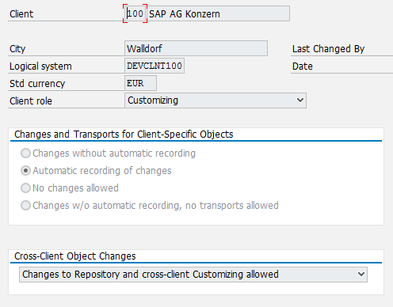
IV. Development Prerequisites SAP Client configuration
A properly configured client is necessary for development
Access to the repository is needed
Configuration in transaction SCC4
Client Role C (Customizing)
Changes should be allowed

Slide 13
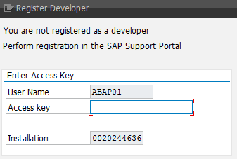
IV. Development Prerequisites SAP User configuration
A user with a development profile and an access key is needed
The access key allows development of new programs or changes to existing ones
The access key is always username dependent
Access keys must be requested from SAP
License costs increase by the number of development users
Access keys can be obtained from your local UCC

Slide 14
IV. Development Prerequisites Creation of a package and a transport request
For development an own package and an own transport request are needed
Packages allow you to group your developments
Transport requests enable you to transport new developments to other SAP systems
It is not possible to transport developments when using the local package $TMP

Slide 15
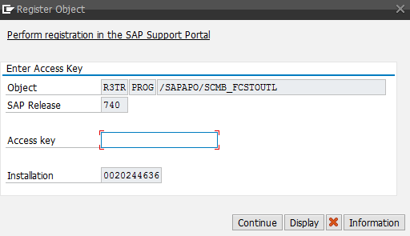
IV. Development Prerequisites Namespaces
Important: pay attention to namespaces!
SAP uses namespaces from A to X for their own programs and implementations
Companies can register their own namespace
A namespace is unique and can only be assigned to one company
Developer namespaces begin with Y or Z (e.g. ZZ_*)
When modifying a program outside the development namespace a modification key has to be entered
Notice the difference: register object instead of register developer

Slide 16
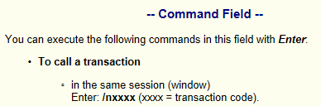
V. Using Help Using different Help options (separate with screenshots)
F1 Help: press F1 to get help to the currently selected item
F4 Help: press F4 in an input field when the symbol is shown for a list of all valid values
Links:
SAP Community Network: http://scn.sap.com
SAP Marketplace: http://service.sap.com/
ABAP Help: http://help.sap.com/saphelp_nw74/helpdata/de/4a/24dbfa64550455e10000000a421937/frameset.htm
Books
The Official ABAP Reference, SAP PRESS, ISBN-13: 978-1592290390
ABAP-Objects, SAP PRESS, ISBN-13: 978-1592290796

Slide 17
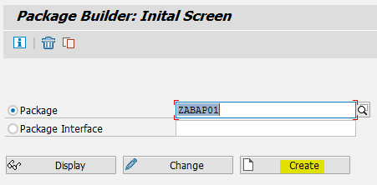
VI. Development of a first application A Hello World application – Step 1
First an own package has to be created (Transaction SE21 – Package builder)

Slide 18
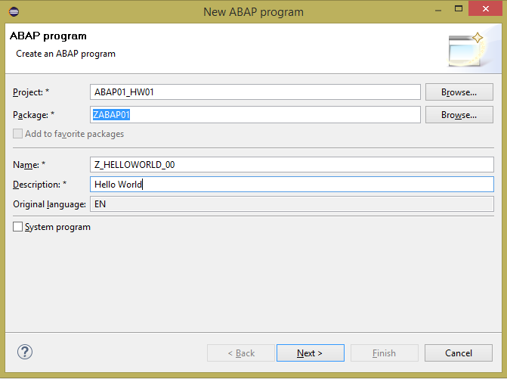
VI. Development of a first application A Hello World application – Step 2
Create your program

Slide 19

VI. Development of a first application A Hello World application – Step 3
Now add your code
Code for report Z_HELLOWORLD_00
Writes “Hello World” on the screen. Note the closing dot (similar to semicolon in Java or C#)

Slide 20
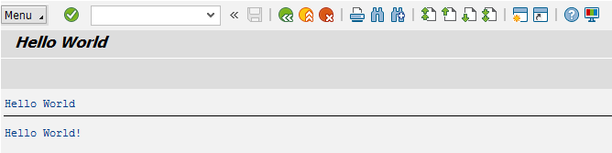
VI. Development of a first application A Hello World application – Step 4
Finally activate your code and run the application
The SAP system always executes the last activated version of a program
If your program has not been activated after changing the code, the version before the changes were made will be executed

Slide 21
Now you know the very basics of ABAP development.
To consolidate your knowledge, you can do the Introduction exercise.

Slide 22
Check your knowledge

Slide 23
Check your knowledge
An ABAP report can only be executed in the background.
□ True □ False
Which requirements have to be fulfilled in order to release a transport request.
□ Code has been successfully written to the filesystem □ Its Tasks have to be released
□ You have to be owner of the request
Which ABAP reports can be created with only having an access key for developers.
□ SAPLWB_INITIAL_TOOL □ A_CALCULATOR □ Z_CALCULATOR □ BMW_I8

Slide 24
Solution

Slide 25
Solution
An ABAP report can only be executed in the background.
□ True ☒ False
Which requirements have to be fulfilled in order to release a transport request.
□ Code has been successfully written to the filesystem ☒ Its Tasks have to be released
□ You have to be owner of the request
Which ABAP reports can be created with only having an access key for developers.
□ SAPLWB_INITIAL_TOOL □ A_CALCULATOR ☒ Z_CALCULATOR □ BMW_I8

